Slide 1

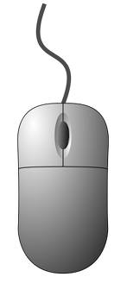
Using Mouse Mischief
in the classroom
Marina Möller
St Johns College
5 July 2011

Slide 2

Traditional way:
teachers teach
use media (charts, transp, PP)
ask questions – some learners answer
handout worksheets
assess learners afterwards

Slide 3

Mouse Mischief way:
teachers teach
use media (charts, transp, PP)
ask questions in PP with MM
all learners participate
assess learners in class

Slide 4

Mouse Mischief is:
Free additional application included
with MicroSoft PowerPoint 2007/2010
Permits teachers to insert slides with
variety of activities
Learners participate actively by using
their own mice

Slide 5

Advantages of MM
learners get immediate feedback
good for reviewing lessons
learners understand content easier
whole class is involved

Slide 6
More advantages of MM
encourages class discussions
engages learners through interactivity
encourages teamwork
improves learning experiences
it’s a lot of fun

Slide 7
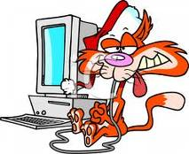
Disadvantages of MM
large classes can have problems
connecting too many mice to one
computer
learners get distracted, play with
mouse – control
need laptop, data projector, Windows 7,
Office 2007/2010, wireless mice, hubs
with multiple USB ports, batteries

Slide 8
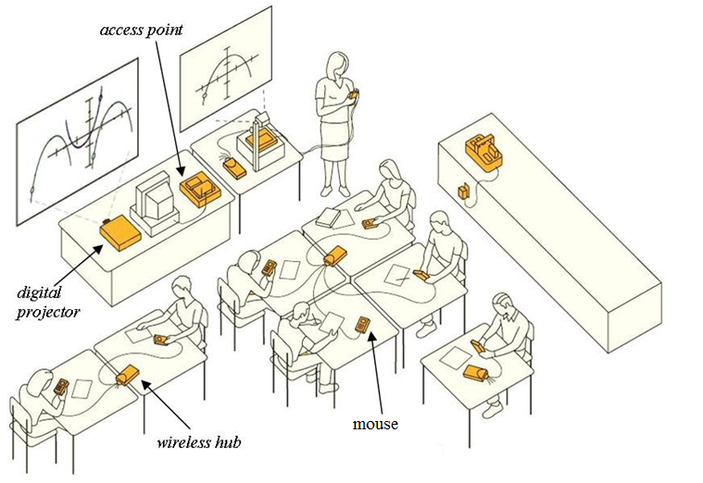
Mouse Mischief setup

Slide 9
Enjoy a mischievous evening

